Slide 1
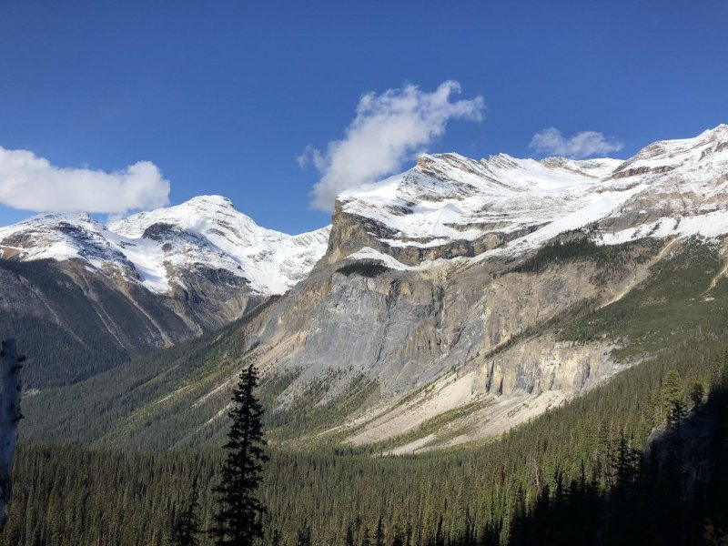
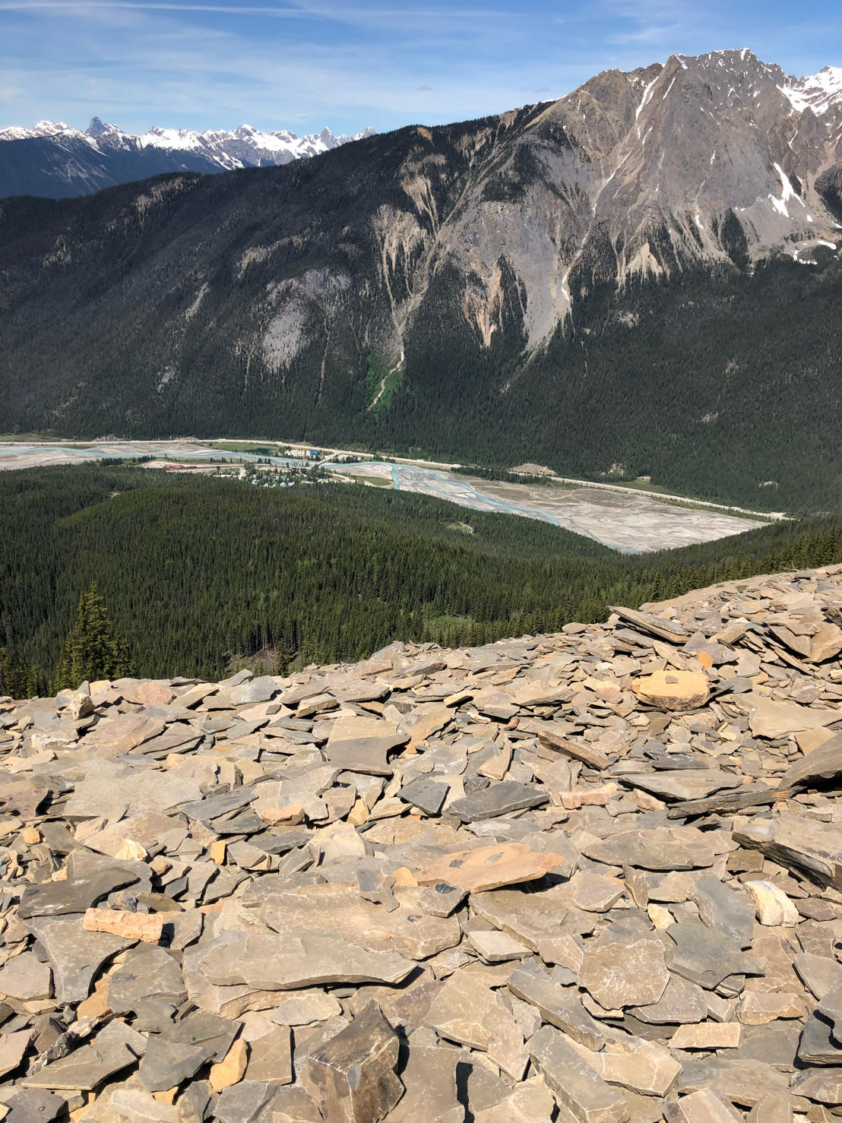
Facies Classification Project by Lida Goldchteine
Geophysicist, P.Geo
BA Economics, Applied Energy Economics
Geoscience Guide with Burgess Shale Geoscience Foundation
https://www.burgess-shale.bc.ca

Slide 2
References:
Marcelo Guarido 2019, Machine Learning Strategies to Perform Facies Classification, Abstract from 2019 Geoconvention
Hall, B., 2016, Facies classification using machine learning: The Leading Edge, 35, No. 10, 906–909.
Dubois, M. K., G. C. Bohling, and S. Chakrabarti, 2007, Comparison of four approaches to a rock facies classification problem: Computers & Geosciences, 33, no. 5, 599–617, http://dx.doi.org/10.1016/j. cageo.2006.08.011.
https://github.com/mycarta/2016-ml-contest/tree/master

Slide 3
Original data : 5 logs, Facies, 2 geological features
The seven predictor variables are:
Five log curves include gamma ray (GR), resistivity (ILD_log10), photoelectric effect (PE), neutron-density porosity difference and average neutron-density porosity (DeltaPHI and PHIND
Two geologic constraining variables: nonmarine-marine indicator (NM_M) and relative position (RELPOS)
The nine discrete facies (classes of rocks) are:
Nonmarine sandstone
Nonmarine coarse siltstone
Nonmarine fine siltstone
Marine siltstone and shale
Mudstone (limestone)
Wackestone (limestone)
Dolomite
Packstone-grainstone (limestone)
Phylloid-algal bafflestone (limestone)

Slide 6
Look at features with strong correlation to assist in classification of the Facies

Slide 7
Facies Distribution
Description fof the Facies:
1 - Nonmarine sandstone
2 - Nonmarine coarse siltstone
3 - Nonmarine fine siltstone
4 - Marine siltstone and shale
5 - Mudstone (limestone)
6 - Wackestone (limestone)
7 - Dolomite
8 - Packstone-grainstone (limestone)
9 - Phylloid-algal bafflestone (limestone)

Slide 8
Missing Features : PE is absent in two out of nine wells

Slide 9
Using two single wells ran models to find a model to create PE from other features
FeaturesUsed:
1.GR
2.Resistivity
3.Density
4.Facies
5.NM
6.REPOS
Model | Model’s R2
Random Forest | 87%
Gradient Boosting Regressor | 85%
Linear Regressor | 77%
KNN | 72%
Split 80/20 train/test

Slide 10
Prediction and validation for PE using Cross H Cattle well
R2 score for LR 87,4 %
MSE LR: 0.05371354095449103
R2 between actual and synthetic is 93%

Slide 11
Creating synthetic or calculated PE logs using information from 7 wells using RF
RF = RandomForestRegressor(n_estimators =100, random_state = 4 )
R2 score: 84%
MSE_RF: 0.130

Slide 12
Choose model to classify Facies from 9 wells
Model | R2
Decision Tree Classifier | 71%
KNN Classifier | 69%
Support Vector Classifier | 58%
GNB | 45%
Random Forest Classifier | 81%
80/20 Train/Test

Slide 13
Use Randomized Search CV to find optimal parameters for RF
Description fof the Facies:
1 - Nonmarine sandstone
2 - Nonmarine coarse siltstone
3 - Nonmarine fine siltstone
4 - Marine siltstone and shale
5 - Mudstone (limestone)
6 - Wackestone (limestone)
7 - Dolomite
8 - Packstone-grainstone (limestone)
9 - Phylloid-algal bafflestone (limestone)
n_estimators': 1000, 'min_samples_split': 2,’ min_samples_leaf’: 1 'max_features': 'sqrt’, 'max_depth': 20 bootstrap': True
R2= 88%

Slide 14
Classification Report
Facies | Facies Labels | Precision | Recall | F1_score | Support
1 | SS | 0.98 | 0.73 | 0.83 | 55
2 | CSiS | 0.81 | 0.89 | 0.85 | 166
3 | FSiS | 0.84 | 0.84 | 0.84 | 159
4 | SiSh | 0.88 | 0.79 | 0.83 | 62
5 | MS | 0.69 | 0.75 | 0.72 | 48
6 | WS | 0.76 | 0.77 | 0.77 | 133
7 | D | 0.81 | 0.78 | 0.79 | 27
8 | PS | 0.81 | 0.81 | 0.81 | 141
9 | BS | 0.82 | 0.78 | 0.8 | 23

Slide 15
Final Result – Predicting facies using RFC
Correlation coefficient Facies vs Prediciton is - 0.98 %
Need to do more work to eliminate overfitting

Slide 16
Thank you
Everyone at RoboGarden
Dr. Qazi for his passion and patience
TAs Kanishqk and Fatemah for their endless hours with us without water and food breaks
RoboGarden students!!!!

